Slide 1
Rural Development Business Center – Servicing & Asset Management Office
Farm Service Agency NACS/NASE National Convention –
June 2023

Slide 2
Contact Information – Guaranteed Commercial Branch (GCB)
Name | Email | Phone | State Assignments
Sharon Sachs | sharon.sachs@usda.gov | 314-679-6804 | Branch Chief
GCB FLP Team | Branch email: sm.rd.so.gcb@usda.gov | Main Line 314-457-6402 | ECM Fax: 314-457-4539
Monique Kelly FLP Lead Accountant | monique.kelly@usda.gov | 314-457-4103
Mattie Bedwell Accountant | madeline.bedwell@usda.gov | 314-457-4036 | AR, AZ, CA, CO, IL, IA, LA, MT, NE, NV, NM, OK, OR, TN, AK, HI, WP
Nina Chery Accountant | nina.chery@usda.gov | 314-457-4281 | CT, FL, KS, MA, MN, NY, RI, SC, SD, WV, PR, VI
Barbara Jungenberg Financial Specialist, ECM Contact | barbara.jungenberg@usda.gov | 314-679-6805 | AL, DE, GA, ID, IN, KY, ME, MD, MI, MS, MO, NH, NC, ND, NJ, OH, PA, TX, UT, VA, VT, WA, WI, WY

Slide 3
Other Contact Information – Guaranteed Commercial Branch (GCB)
* EFT Validations for Direct or Guaranteed Loans:
Finance Office - Cash Reporting Division - Disbursements Branch –
* Branch Chief is Sharon Maull
* email: rd.cfo.db@usda.gov
* phone: 314-457-4031
* Pre-Authorized Debit (PAD) agreements for Direct Loan borrowers:
Finance Office - Cash Reporting Division - Collections Branch –
* Branch Chief is Candy Wall
* email: rd.cfo.cb@usda.gov
* phone: 314-457-4023
* For questions on PAD for Guaranteed Loan Lenders:
* refer to Quick Reference Guide or contact your GCB rep (from previous slide)

Slide 4
Quick Reference Guides – Guaranteed Commercial Branch (GCB)
The GLS Quick Reference Guides are available at Training (usda.gov) under Training Guides and Software User Guides.
4A-Change in Case Number & Loan Number
4D-Change in Case Number, Name & Address
9G-Change in Borrower Mail Code GLS transactions
Application Authorization Security Management (AASM)
Guaranteed De-obligations
Guaranteed Farm Loan Systems
Guaranteed Loan Debt Offsets
Guaranteed Consolidations
Guaranteed Loan Closings in GLS
Guaranteed Lender PAD in GLS
Guaranteed Loan Restructures in GLS
Guaranteed Loan Borrower Adjustments FSA-2247
Guaranteed Obligations
Guaranteed Transfers & Assumptions in GLS
EFT for Guaranteed Loans
LINC for Lenders
Level 2 eAuth Accounts
Semi-Annual Status Reports
Notes:
Please let us know if there are any suggestions on a new quick reference guide topic.

Slide 5
Automation updates: NASE Resolution – Guaranteed Commercial Branch (GCB)
Handbook requirement
As per Handbook 2-FLP subparagraph 266C: “Upon receiving FSA-2248, the authorized agency official will review the information to determine whether follow-up action is necessary. The findings of the review along with any planned follow-up action will be entered into the Comments Section of the Default Status Report Screen in GLS. The initials of the reviewer and the date of the review will also be entered into the Comments Section to document the review.”
GLS Enhancement (Implemented Sept 2022)
The GLS Status/Default Report screens have been updated to include an entry section for Reviewer Name and Review Date. Due to prior limitations in GLS the entire comments section would not print which limits the ability for FLP staff to monitor the account as per Handbook 2-FLP. The comments section has been enlarged. This allows the user to print the entire comments section up to 2000 characters.
Notes:
Although 2-FLP only requires documentation of the default status review in GLS, both the GLS Status/Default report screens have been updated to reflect these enhancements. This provides county offices a way to also track reviews of Status reports.

Slide 6
Other Automation Updates – Guaranteed Commercial Branch (GCB)
In October 2022, we changed the Credit Bureau reporting for IRA so negative information is not reported. Instead of showing that a loss was paid, or debt was written off, the code only indicates “Other – IRA”.
In November 2022, we removed all changes that had been made in preparation for ARPA.
In January 2023, we added an edit to prevent the ‘Received Date’ on the Application from being changed to a date after the ‘Completed Date’.
In January 2023, we updated GLS to systematically change the Final Advance Date to the Restructure Date if the Restructure Date is before the current Final Advance Date when we process a restructure.

Slide 7
Other Automation Updates – Guaranteed Commercial Branch (GCB)
In February 2023, we updated the Interest Rate links in the Lender section of the Loan Closing transaction. The 3-month LIBOR link was changed to the Secured Overnight Financing Rate (SOFR). The link for the 5-Year Treasury Rate was also update to go to a different website.
In March 2023, The Digital Infrastructure Services Center (DISC) migrated the Mainframe Security from ACF2 to RACF. Changes were not visible to the users.
In April 2023, we implemented a correction to data-filled Form 2235 where the Guaranteed Amount would round down instead of rounding up. This was only occurring when the Guarantee Percent was anything other than 90% and there was a 5 in the hundredths place ($00,000.005).
Notes:
Maximum interest rate rules were updated in March 2022 (2-FLP, Paragraph 135)
Replaced the use of the 3-month LIBOR with the SOFR and adjusted the related allowable mark-up
At the time of loan closing or restructuring, the interest rate charged by the lender cannot exceed one of the following as applicable:
For loans with variable rates or rates fixed for less than 5 years: 6.75% above the prior business day’s SOFR rate
For loans with rates fixed for 5 or more years: 5.5% above the prior business day’s 5-year Treasury note rate
In the event that the SOFR falls below 1.75%, each of the maximums above may be increased by an additional 1%

Slide 8
Automation updates: GLS web page upgrade – Guaranteed Commercial Branch (GCB)
In April, an upgrade was done in GLS to satisfy a security requirement to keep the code base up to date. Due to the upgrade, the following screens will no longer work in Edge-IE mode:
GLS Borrower List
View Borrower Information
Borrower Maintenance pages –
Add Individual or Organization Borrowers
Update both Individual and Organization borrowers
Add Co-borrower function
(there was an additional upgrade to replace an unsupported census address service to a supported address verification service on this screen)
GLS reports and data-filled forms still require use of Microsoft Edge ran in IE mode to function properly. On the next slide, you will find information on how to configure your browser settings for optimal use of GLS.
Notes:
Email was sent out by Monique on 4/19/23
However, GLS reports and data-filled forms still require use of Microsoft Edge ran in IE mode to function properly. Below you will find information on how to configure your browser settings for optimal use of GLS.
Microsoft Edge Settings:
If you use GLS to run reports or open data-filled forms, you may want to add https://gls.sc.egov.usda.gov/reports_gls.asp and https://gls.sc.egov.usda.gov/forms_fsa_data.asp to your Internet Explorer compatibility list (see instructions below). You will need to remove any other GLS pages from the list of pages to load in IE mode.
*To Set Reports and Forms to load in IE Mode:
1. Open Microsoft Edge
2. Click on the ellipse (3 dots) in the upper righthand corner of the Edge browser, and select ‘Settings” and then “Default Browser”.
3. Under Internet Explorer compatibility, click on the ‘Add’ button and enter https://gls.sc.egov.usda.gov/reports_gls.asp to add the GLS site to the list of pages that will automatically open in Internet Explorer mode.
4. Repeat Step #3 to add https://gls.sc.egov.usda.gov/forms_fsa_data.asp.
*Users will need to update the list of sites every 30 days*

Slide 9
Automation Updates: GLS Reports & Forms – Guaranteed Commercial Branch (GCB)
GLS Reports
Reports are still available in GLS under FSA Reports. These reports must be opened in Microsoft Edge-Internet Explorer mode. See IE Mode instructions below.
GLS Data-Filled Forms
The following Data-Filled Forms open in Microsoft Edge-Internet Explorer mode only. See IE Mode instructions below.
FSA 2231
FSA 2232
FSA 2235
FSA 2254
Run Microsoft Edge in IE Mode: In Microsoft Edge: Use the option to “Load in Internet Explorer Mode”. This is done by clicking on the ellipse (3 dots) in the upper righthand corner of the Edge browser. Select ‘Settings” and then “Default Browser”. Then click on the ‘Add’ button and enter https://gls.sc.egov.usda.gov/fsa_reports.asp to add FSA Reports to the list of pages that will automatically open in Internet Explorer mode. Also add https://gls.sc.egov.usda.gov/forms_fsa_data.asp to add Data-Filled Forms to the list. Users will need to update the list of sites every 30 days.
Notes:
Forms
Form 2231 - Request for Obligation of Funds – Guaranteed Loans
Form 2232 – Conditional Commitment
Form 2235 – Loan Guarantee
Form 2254 – Guaranteed Loan Report of Loss

Slide 10
Automation Updates: Internet Explorer Mode Demo – Guaranteed Commercial Branch (GCB)
IE Mode Demo
Notes:
Run Microsoft Edge in IE Mode: In Microsoft Edge: Use the option to “Load in Internet Explorer Mode”. This is done by clicking on the ellipse (3 dots) in the upper righthand corner of the Edge browser. Select ‘Settings” and then “Default Browser”. Then click on the ‘Add’ button and enter https://gls.sc.egov.usda.gov/fsa_reports.asp to add FSA Reports to the list of pages that will automatically open in Internet Explorer mode. Also add https://gls.sc.egov.usda.gov/forms_fsa_data.asp to add Data-Filled Forms to the list. Users will need to update the list of sites every 30 days.

Slide 11
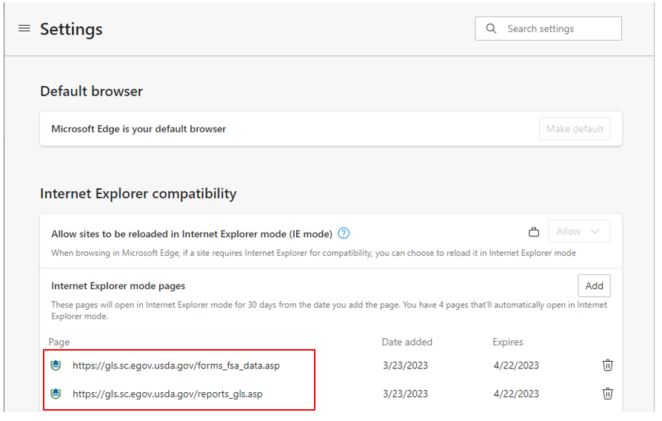
Automation updates: IE Mode Settings – Guaranteed Commercial Branch (GCB)
Updated Browser Settings
Be sure that only the below two pages are listed. If any other GLS pages are listed, you can click on the trash bin to remove them.

Slide 12
GLS Reports Conversion: Updates – Guaranteed Commercial Branch (GCB)
Tableau Project Update
The following five WebFocus reports have been converted to Tableau and published. Published reports are available on the FPAC landing page, https://cxodashboard.dl.usda.gov/#/site/FPAC/views/FPACLandingPage/FPACLandingPage:
Certified and Preferred Loan Providers
Guaranteed Analysis by Interest Rate
Guaranteed Loans Pending Closing in GLS
Overdue Guaranteed Loan Closing Fees
Re-amortized Guaranteed Loans
Approximately 30 reports have been developed and are in User Acceptance Testing (UAT). More than 100 reports also need to be developed or reworked.
Detail reports in Excel format are currently being prioritized before any summary reports or PDF views are worked, with some exceptions.

Slide 13
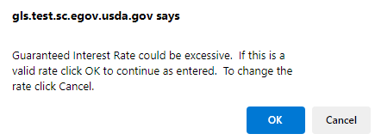
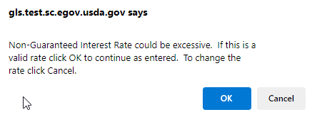
Guaranteed Loan Reminders: GLS Interest Rates – Guaranteed Commercial Branch (GCB)
Interest Rate Warning
On the Loan Guarantee Request screen, anything over 10% generates the messages shown below:
Notes:
These messages are just warnings to prevent any interest rate typos but can be bypassed by simply clicking OK.

Slide 14
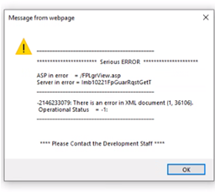
Guaranteed Loan Reminders: GLS Agency Comments – Guaranteed Commercial Branch (GCB)
GLS Agency Comments
To avoid page errors in GLS, do not copy and paste to GLS. GLS is not able to interpret all special characters that may be pasted in GLS.
If special characters are saved in the agency comments, user will experience the below error. Contact the GCB to get the problem fixed.
Notes:
GLS screens with Agency Comments include Loan Guarantee Request, Loan Closing, Semi-annual and Default status reports, FSA Reviews, Loss Claim Maintenance.

Slide 15
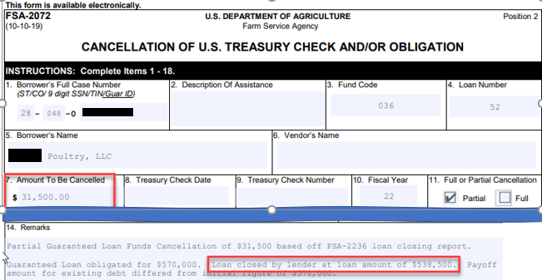
Guaranteed Loan Reminders: De-obligations – Guaranteed Commercial Branch (GCB)
De-obligation Requests
When submitting de-obligation requests, please include the new obligation amount in the comments.
Notes:
This allows us to double check the math. We have had accounts where the 1D was processed for the wrong amount because of a calculation error.

Slide 16
Guaranteed Loan Reminders: Debt Collections & Loss Recoveries – Guaranteed Commercial Branch (GCB)
Debt Collections
Funds should be deposited through NRRS. Common collection codes include Collection Code ’33’ for Recoveries, ’80’ for Voluntary collections, or ‘82’ for Debt Settlement payments.
For loans eligible for Offset, no additional forms are required, and no additional claim is needed in GLS.
Loss Recoveries
To be processed for loans with a final loss and are NOT subject to Offset:
The Loss must be entered in GLS using the ‘Click here to add Loss Claim’ hyperlink on the View Loan screen. Select Loss Type: ’04’ for Recoveries, ’13’ for Voluntary Payments, or ’14’ for Compromise Offers.
Recovery payment should be deposited through NRRS. After payment is entered in NRRS, GLS Form 2254 should be signed and submitted to GCB for processing. (Only one FSA signature is required on the form.)
Notes:
Guaranteed Loan Collection Codes
30 – Guarantee Fees
31 – Repayment of Appraisal Fee
32 – Payment on Repurchased guaranteed loan
33 – Lender Recovery or Final Loss Refund*
34 – (Finance office use only)
35 – Other guaranteed loan remittance
70 – Internal Administrative Offset (IAO) – Other
71 – IAO – DCP
72– IAO –LCP
73– IAO –CRP
74– IAO –EQIP
75– IAO –Tobacco
76– IAO –Peanuts
77– IAO –Rice
78– IAO –LDP/Market Asst Loan
79– IAO –DCC Stay status
80 – Voluntary*
81 - DOJ
82 – Debt Settlement*
83 - Other
84 – TOP
Loss Types:
04 – Recovery after Final Loss
13 – Voluntary Payment
14 – Compromise Offer

Slide 17
Guaranteed Loan Reminders: Loan Closings – Guaranteed Commercial Branch (GCB)
Advance Amount
Please be sure to include the correct advance amount when processing a loan closing in GLS. This will help reduce errors on the Status Reports.
Line of Credit
The Maturity Date and Period of Advances entered on the Loan Closing should reflect the entire term of the Line-of-Credit.
Notes:
Loan Closing –
If the lender advanced funds at closing, but it is not entered on the Closing transaction, it causes an error on the status report because the Unpaid Principal will exceed the Principal Advanced. The loan closing in GLS should reflect the lender’s loan closing. FO loans are normally fully advanced at closing unless it is a construction loan.
On LOC, the Maturity Date should reflect the entire term of loan. They should NOT enter as 1 year term to be renewed each year. What we are seeing is the LOC is set up with a 1-year term to be renewed each year. Then after year 1, we get a 2249 to restructure the loan for another year. Once the loan is restructured, they are no longer allowed to make advances on the loan…..so it defeats the purpose of an LOC.

Slide 18
Guaranteed Loan Reminders: Other Loan Processing – Guaranteed Commercial Branch (GCB)
Loan Restructures
Restructures should not be sent for a future date and the entire form should be completed to eliminate assumptions. Also, the New Loan amount should equal Capitalized Interest plus Principal.
Obligations
OK code 7-”Override” can be used on an obligation if the new loan is used to payoff a current loan to not exceed the loan limit. Once the loan has closed, any loans being paid in full by the new loan should be terminated so the borrower does not exceed the total indebtedness limit.

Slide 19
Questions

Slide 20
Servicing Office
Farm Loan Branch Overview
Notes:
Good Morning Everyone! I’m Antoinette Taylor, Section 1 Supervisor for FLB. FLB would like to thank you for inviting us to the yearly NASE/NACS convention here in Omaha. We are always excited for the meet and greet and sharing of information. It is such a pleasurable experience meeting everyone and putting names to faces.

Slide 21
Servicing Office Org Chart
Notes:
Here is an overall view of the Servicing Office’ Organization Chart from the Director to the Division level

Slide 22
Overview of the Farm Loan Branch (FLB)
Servicing Office mission: Provide loan servicing performance and efficiency for Rural Development (RD) and Farm Service Agency (FSA) programs through exemplary customer service and fiscal stewardship while cultivating a highly productive workforce.
The Farm Service Agency offers loans to help farmers and ranchers get the financing they need to start, expand or maintain a family farm. FLB has a “Service Level Agreement” with the Farm Service Agency to provide servicing and financial reporting functions for the Farm Loan Program portfolio.
The Farm Loan Branch is mainly responsible for planning, organizing, directing, and coordinating loan servicing and management reporting activities related to the development, maintenance, and operation of the detail “accounting systems” for direct loans in the Farm Loan Portfolio.
Notes:
The Serving Office will continue to work closely with and support FSA; providing exceptional loan servicing and financial reporting functions for the Farm Loan Program portfolio.

Slide 23
Overview of the Farm Loan Branch (FLB) – Cont.
Team members process a full range of borrower accounting transactions for all direct loans serviced by the Farm Loan Program portfolio, such as discrepancy processing, consolidations, re-amortizations, refunds and change-in-application of payments.
FLB currently processes transactions out of two systems which are the Program Loan Accounting System (PLAS) and Direct Loan System (DLS).

Slide 24
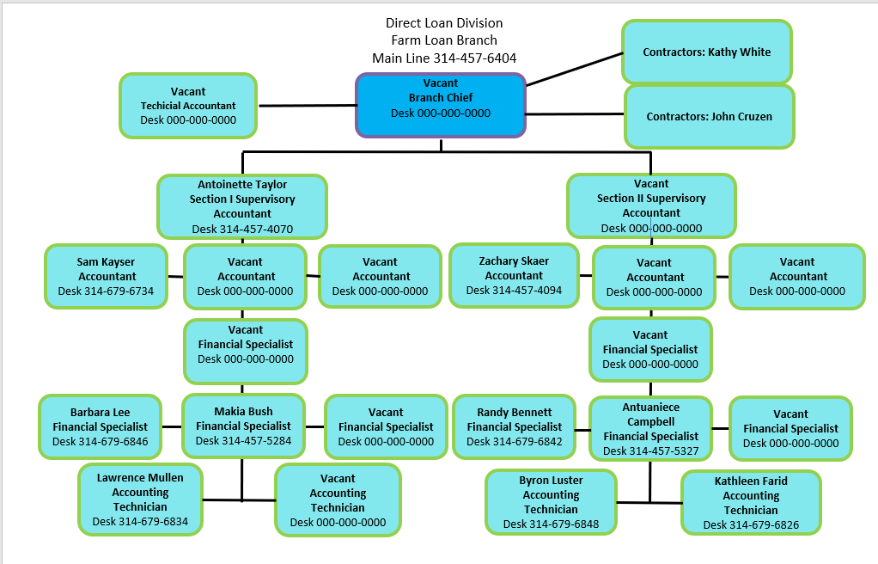
FLB Organization Chart – Staffing Feb 2023 June 2023
Notes:
In Feb 2023; FLB had 11 vacancies: 1 Branch Chief, 1 Section 2 Supervisor (S2S), 4 Accountants, 4 Financial Specialists (FS), and 1 Accounting Technician
As of June 2023: FLB has selected Lisa Randolph as Branch Chief. We have hired 3 Accountants, 1 FS, and 1 Accounting Technician. We are in process of hiring 1 S2S, 1 additional Accountant, and 3 additional FS. Once hiring is complete, FLB will be fully staffed with 23 employees.

Slide 25
Contact Information – Farm Loan Branch

Slide 26
Farm Loan Portfolio Stats as of December 31, 2022
Portfolio | Unpaid Principal Balance | # of loans
FSA | $32,405,567,907B | 188,878

Slide 27
Outreach Initiatives
Production Stats
IRA – 17,532 Lines Manually Processed
Phase 1 – 1604
Phase 2 – 5632
Phase 3 – 5400
BBB_DSA_Manual Payments – 916
Additional Payments – Versions 1-6 – 3260
Corrections/Urgent Requests – 720
Notes:
Farm Loan Branch will continue to work along side National Office to process Inflation Reduction Act (IRA) payments and any requested corrections.
Several projects and urgent requests have neared completion since 10/2022. FLB continue to work through corrections and "one off" payments for Extraordinary Measures and Financially Distressed situations.

Slide 28
Outreach Initiatives Cont.
Production Stats
ECM Requests – 3,280 Completed of 3,584 Received for FY23
ADPS – 62,266 Transactions Processed FY23
Wires - 114 Processed FY23

Slide 29
Direct FLP Processing Times – Farm Loan Branch
5 Business Days:
All Disbursements
Emergency Loan Funds
Emergency Loan Costs
10 Business Days:
FSA 2072, Cancellation of U.S. Treasury Check and/or Obligation
FSA 2425, Request to Cancel Undisbursed Loan Funds
FSA 2732, Request for Settlement of Indebtedness with an Application
FSA 2731, Request for Settlement of Indebtedness without an Application
FSA 2722, TOP or Cross Servicing Refunds

Slide 30
Direct FLP Processing Times Cont. – Farm Loan Branch
12 Business Days:
FSA 2429, Changes in Application of Payment
20 Business Days:
FSA 2560, Request for Statement of Account
FSA 2446, PLAS Account Correction (Type of Assistance Correction, Complex Cases, Refunds of Overpayment)
FSA 2574, Confirmation Reorganization Plan Worksheet (Bankruptcies)
FSA 2576, Notice of Judgement
30 Business Days:
ADPS Discrepancies

Slide 31
Reminders – Farm Loan Branch
ECM Requests
Include on the fax cover sheet an email address(s) for the purpose of emailing the notification receipt letter. If you need to verify the ECM request has been received through fax, please contact the Financial Specialist team
ECM status or questions
Please contact the Accounting Technician that is responsible for the state or the “Assigned to” person listed on the receipt letter for the request in question
If no response in one business day forward the email that was originally sent to the Accounting Technician to our Financial Specialist team
If no response in one business day forward the email that was originally sent to the Financial Specialist to Antoinette Taylor and Lisa Randolph. Always respond to your original email because we need that information to ensure the proper channels were used.
Financial Specialist | Email Adress
Bennett, Randall | randall.bennett@usda.gov
Campbell, Antuaniece | antuaniece.campbell@usda.gov
Bush, Makia | Makia.Bush@usda.gov
Lee, Barbara | barbara.lee@usda.gov

Slide 32
Reminders Cont. – Farm Loan Branch
NRRS requests
Please contact Sue Eilertson at sue.eilertson@usda.gov or at 202-690-9142
FSA 2429
4 FLP directions, Page 5-1
*--Any subsequent correction of applications will be processed in NRRS. For the correction to be updated to borrower’s account, the authorized agency official will need to submit FSA-2429 through RDBCSO, FLB, ECM system. Changes in application of loan payments shall not be for trivial or minor purposes. FSA-2429 must be submitted as soon as the error in application of payment is discovered or by December 31 of the current CY, to not adversely impact FSA issuance of IRS 1098. Only payments received in the current CY can be changed.

Slide 33
Reminders Cont. – Farm Loan Branch
PAD agreements
Please contact Candy Wall – Collections Branch at candy.wall@usda.gov or at 314.457.4017
1098/1099 Quarterly reports
Please contact Debra Deters – Program Reporting at debra.deters@usda.gov or at 314.457.4307
60-day Letters

Slide 34
Known System Issues
Known System Issues
3K-Debt Settlement Reversals associated with the conversion
Type - 4 Transactions (4M-Maturing of Accounts)

Slide 35
IT Initiative
PLAS Replacement project
Scope:
The Scope of this initiative is to replace the Loan Servicing portion of the Legacy PLAS system. Replace
PLAS with a state-of-the-art technical solution that will provide loan servicing, financial reporting, and
adequate internal controls to ensure the FSA and RD loans are accurately reflected, easy to maintain and
serviced, and allow the servicing office to meet customer demands.
Status:
Working with Rural Development Technology Office (TO) on Statement of Objectives (SOO).
Working with TO on project plan to complete SOO and contract strategy/timeline.
Contract Award Estimated Date:
Dependent on completion of the above and completion of contract acquisition documents.
Dependent on funding and available resources.
Estimated Contract Award Date FY 2025.
Notes:
PLAS serves as the financial hub for loan and grant programs for RD and most of FSA as our General Ledger and financial reporting data is consolidated within PLAS. The PLAS Replacement Project is not an update, but a replacement. The mission need is to replace PLAS with a state-of-the-art technical solution that will provide loan accounting servicing, financial and legislative reporting, and adequate internal controls to ensure the FSA-FLP and RD loans are accurately reflected, easy to maintain and service, and allow the servicing office to meet customer demands.
IT is working on known system issues; including 3K-Debt Settlement Reversal associated with the conversion and the 4-type Transactions M-Maturing of Accounts). There is no completion ETA at this time .

