Slide 1
Modernization Project
Enhancing Lender & Borrower Experience​s
June 2023

Slide 2
What’s Cool & Upcoming!
Modernization Project
Swivel Chair Concept
Integration
Producer-Lenders Tools
Streamline Data Entry

Slide 3
1
Modernization Project

Slide 4
Modernization Project
Connectivity
Digitization
Automation
Reporting

Slide 5
The Road Ahead
Improving Tools, Processes and Experiences
Improving User Experience
Improving Asset Class Experiences
New Experiences for Loan Officers, Managers & Leadership
New Credit Assessment Features
Automation, Artificial Intelligence, and Machine Learning

Slide 6
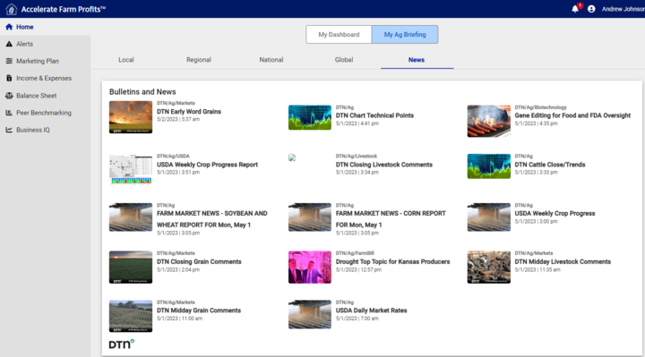
CONNECTIVITY
Integrations & Data Movement
Capabilities
Ag Integrations:
Yield, Satellite Imagery & Commodity Price
News & Weather
Alerts
Batch & Real-Time Data Movement
Bulk Data Extraction
Key Benefits
Gain real time insights into borrower performance
Improved Early Warning & Risk Mitigation

Slide 7
DIGITIZATION
Deliver a Cohesive Ecosystem
Bringing Tech To The Farm
Meet the Farmer on the Farm
Keep the Paper On the Shelf
Digital Farm Inspections
Digital Farm Reviews
Digital Inventory Adjustments
Data Entered One Time
Better Experience All Around

Slide 8
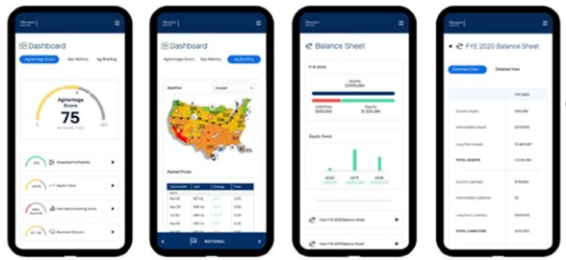
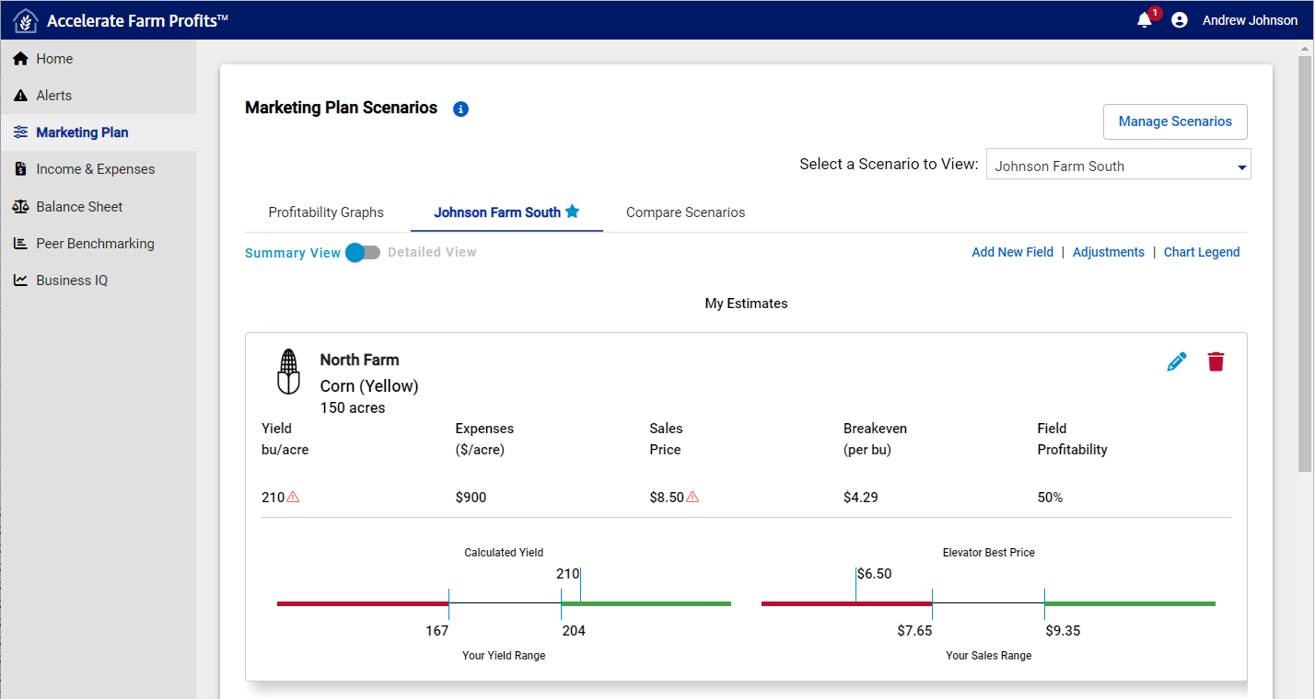
DIGITIZATION
Engagement In A New Way
Producer & Lender Collaboration
Producer:
Farm Overview
Marketing Plans
Living Financial Statements
Peer Benchmarks
Business IQ
Lender:
Portfolio Alerts
Farm Profitability by Producer
Collaboration Tool
Build Producer Financial Literacy

Slide 9
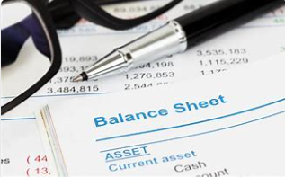
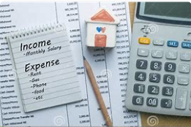
AUTOMATION
Data Ingestion, Workflow, Business Rules
Capabilities
From Paper to Digital
Your Data Where You Want It
Enables End-to-End Data Flow
Key Benefits
Reduced Manual Keying
Improved Data Accuracy
Automation of Redundant Activities
Data Traceability & Audit Log

Slide 10
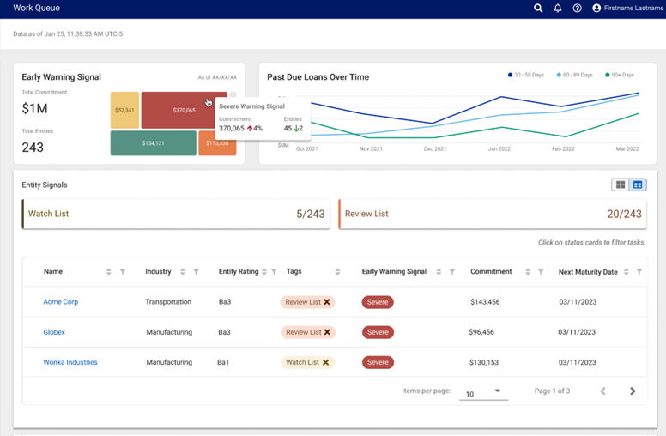
REPORTING
Active Portfolio Monitoring
Capabilities
Measure and manage portfolio-level risk
Quantify portfolio performance indicators
Tunable Early Warning Signals
Key Benefits
Obtain a holistic view of portfolio performance
Gain insights into portfolio performance
Take action on those insights

Slide 11
Modernization Journey
Requirements & Scoping
Design & Consulting
Development
QA & Testing
Training
Production Release

Slide 12
2
Ag Thought Leadership

Slide 13
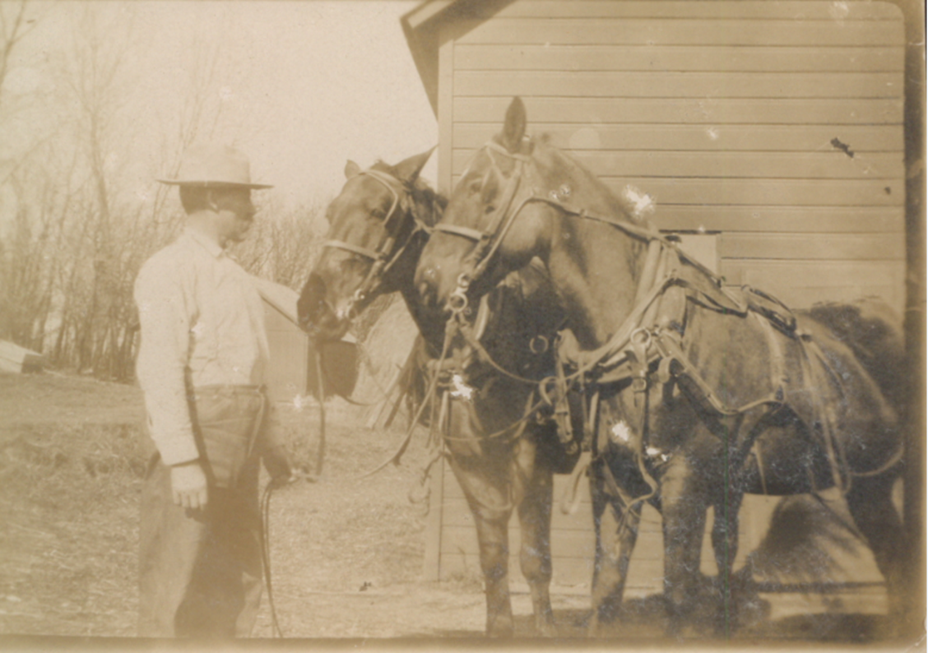
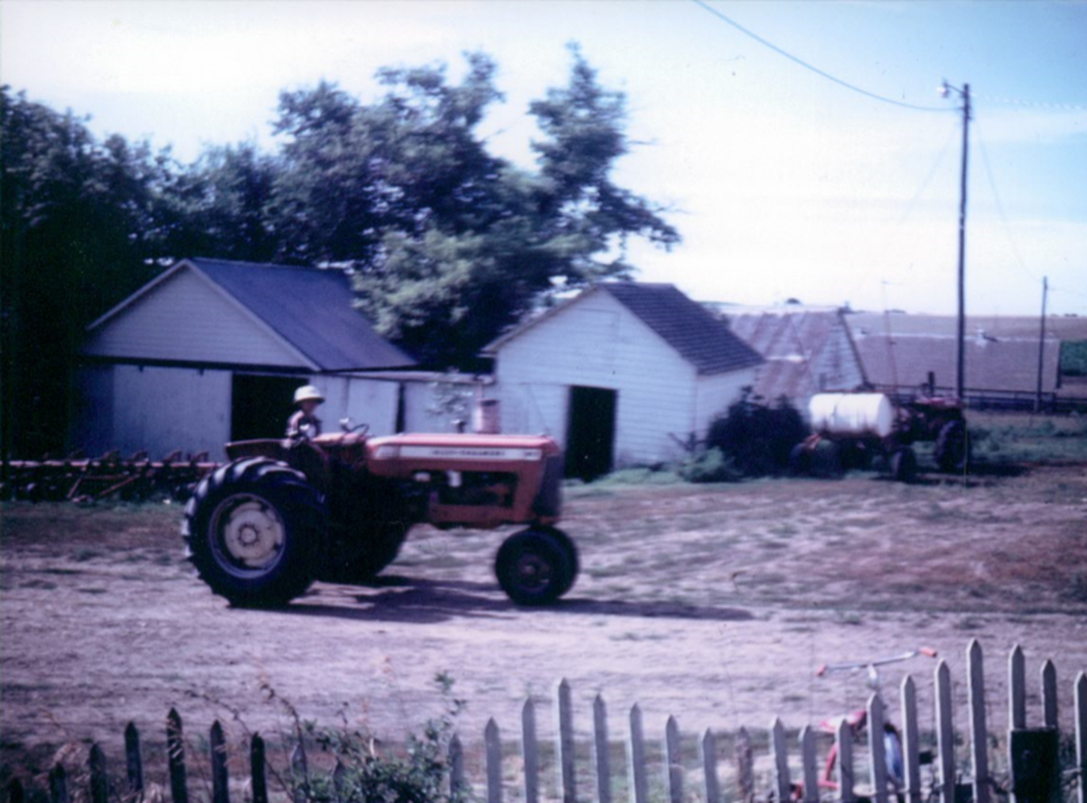
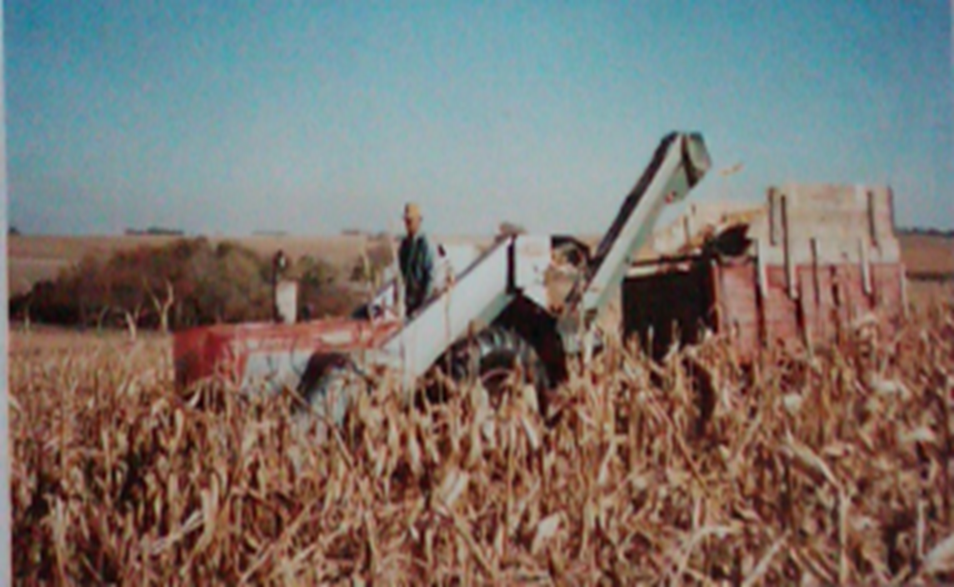
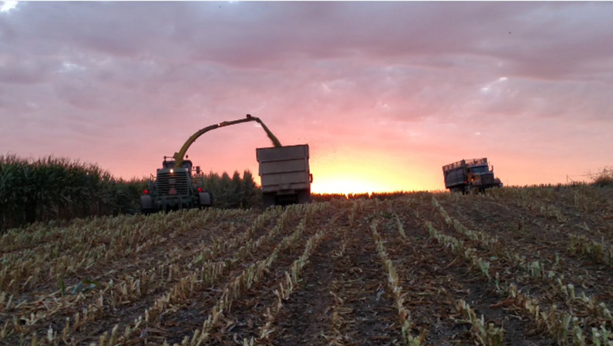
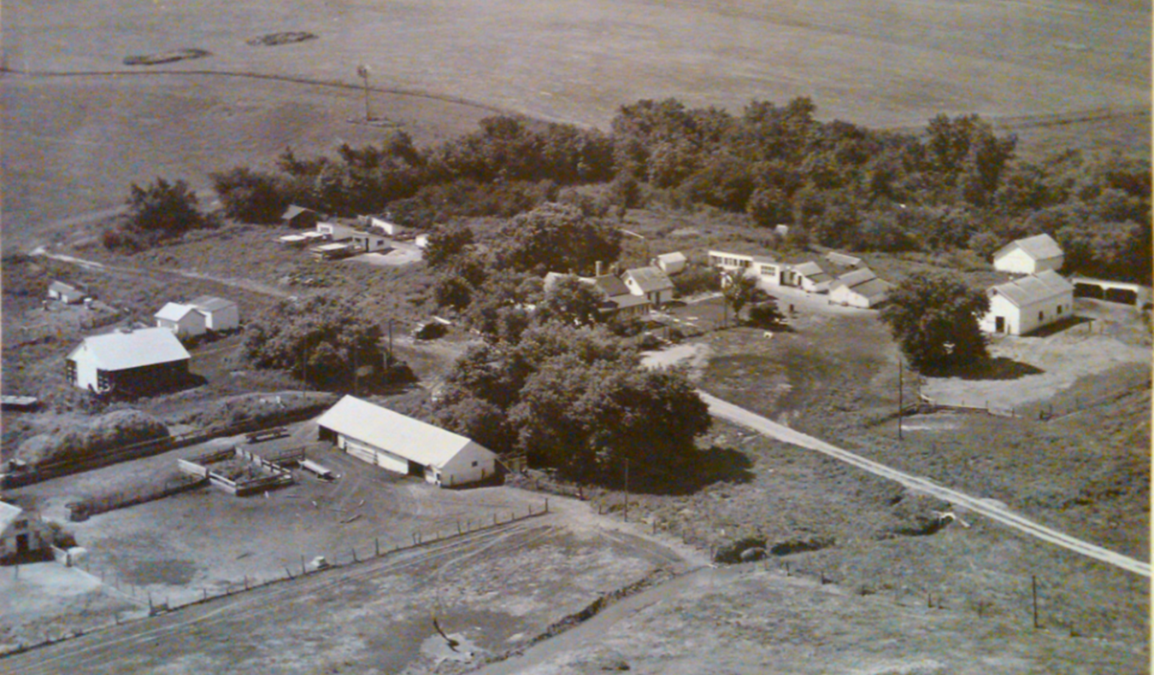
Moody’s Ag Experience
Our Future Isn't About Tradition
It's About Change

Slide 14
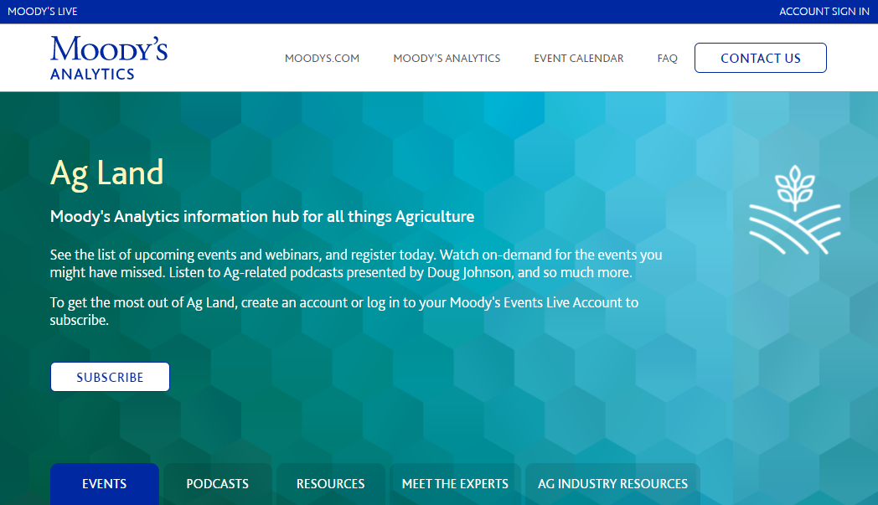
Ag Land Hub
Centralized Ag Repository
Complimentary resource
Create “alerts” for new postings
Webinars
Podcasts
Conferences
Whitepapers
https://live.moodys.io/ag-land-channel

Slide 15
Keep Farmers Farming and Ranchers Ranching
Thank You for Supporting Agriculture

Slide 16
Doug Johnson, Ag Strategist - Industry Practice Lead
Moody’s Analytics
1010 N. 102nd Street
Omaha, NE
Cell: 402-639-4271
douglas.johnson@moodys.com
moodysanalytics.com

