Slide 1
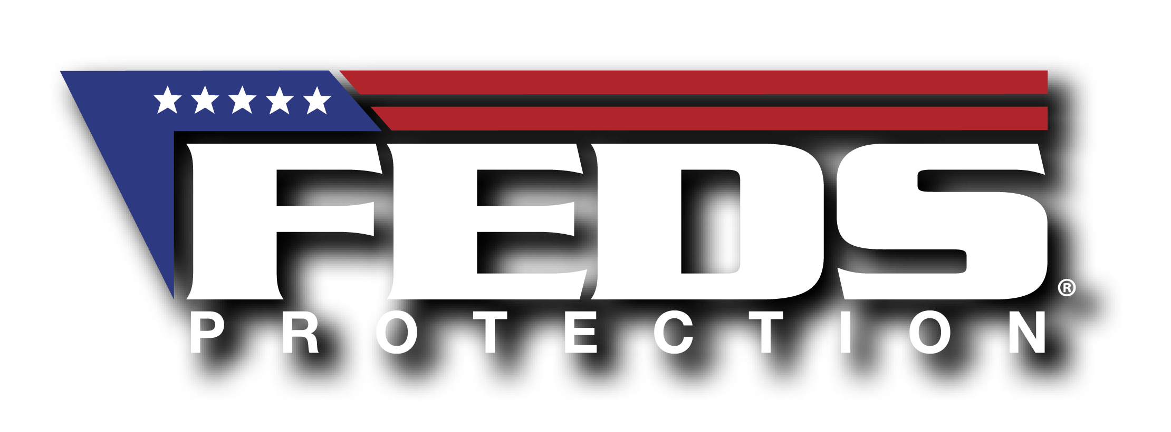
Why Credit Specialists Become the Face of Government Scandals, & How PLI Can Protect You
Eric Impraim, MBA
FEDS Program Director
Caught in the Spotlight
*This presentation and subsequent discussion is provided for educational purposes only. It does not constitute legal advice and is not intended to create an attorney-client relationship. ©2023 FEDS Protection
Notes:
Hi, I’m Eric Impraim, the Marketing Program Director for FEDS Protection
FEDS was founded by Anthony Vergnetti, the President & Founder & former Federal attorney over 16 years ago on a platform of education.
I have been in the insurance industry for nearly 20 years and managed the Federal Program for second largest insurance company in the United States.
I appreciate opportunities to talk about the benefits of PLI with NACS who has been with FEDS since the beginning.

Slide 2
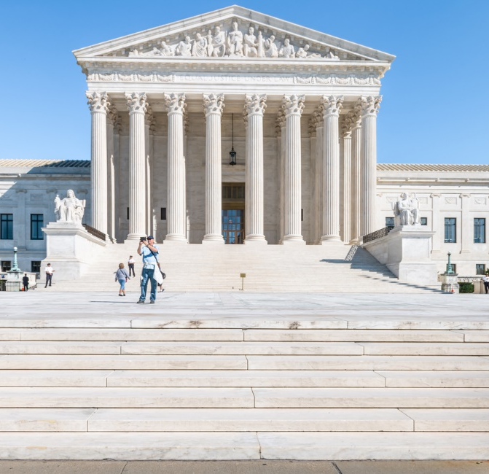
Agenda
Understanding Your Professional Exposures
Providing Context
Explaining Coverage Areas & Benefits
Questions
Notes:
For those who love a little order, this slide is today’s agenda, so you all know what to expect from this presentation.
I’d like to use today’s webinar to focus on the day-to-day challenges that are faced as Credit Specialists, and how FEDS PLI can help.

Slide 3
Loan work
Tough Cases
Internal & External Scrutiny
Environmental Evaluations
Anti – Livestock Groups
EPA Employees Facing Removal over Demands of Accountability
Other Environmental Groups
Supervising employees
Miscellaneous Groups
Notes:
As Credit Specialists, there is a spotlight on everything you do. Your responsibilities run the gambit from day-to-day matters related to management responsibilities – as you all are doing the best you can, with what you have. Each of these distinct areas has its own unique exposures.
What can you do to protect yourselves—well one thing you can do is get PLI because contrary to popular belief credit specialists are not fully protected from either personal (financial) and professional liability just because you’re a federal employee
FEDS Protection has been at the center of almost every major event impacting federal employees; from WACO, to 9/11, the wars, & congressional investigations involving the IRS, GSA, ATF, the VA and most recently, the impeachment proceedings—the insurance has been there every step of the way to help protect every day federal employees.

Slide 4
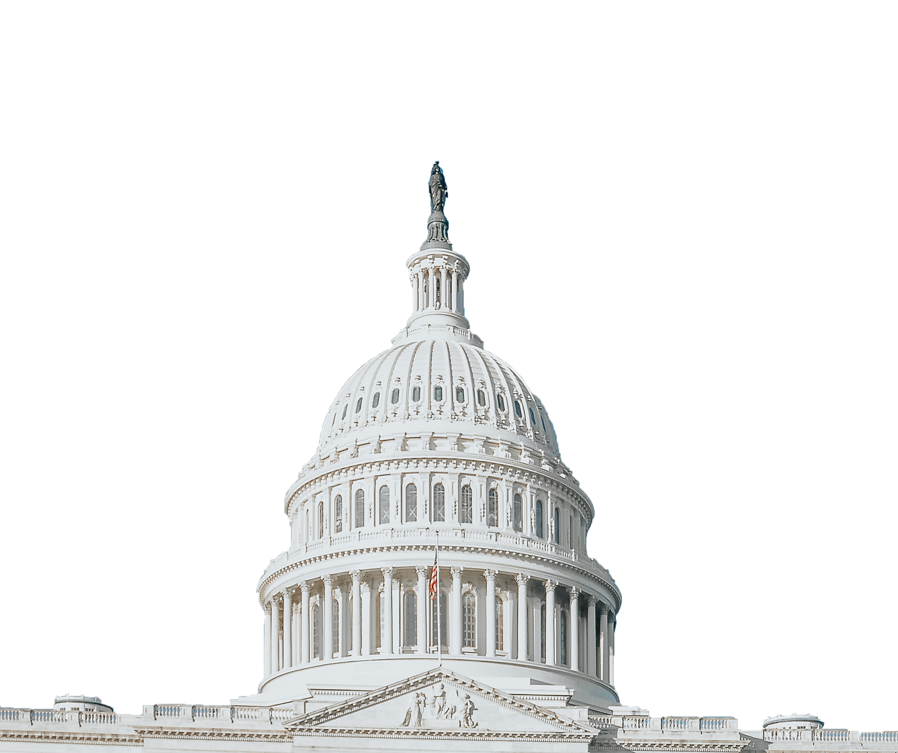
50%
Congress requires agencies to reimburse managers, supervisors, and law enforcement officers up to half the cost of the annual premium for professional liability insurance.
This is an employee benefit that you should be taking advantage of.
Notes:
Many credit specialists know that agencies are required to reimburse up to half the cost of Professional Liability Insurance
And one of the reason this law is here is because good Federal employees does not prevent federal employees from being accused of wrongdoing or sued.
And while you may be ultimately vindicated, the process along the way can easily cost you hundreds of thousands of your own dollars if you do not have a PLI policy in place
This is an employee benefit you should be taking advantage of. You wouldn’t leave your 3% TSP match on the table, you shouldn't’t leave this benefit on the table either

Slide 5
Administrative & Disciplinary Matters
Criminal Investigations
Civil Lawsuits
Notes:
So, in the face of all this exposure in the workplace, how can credit specialists best protect themselves? The answer is Professional Liability Insurance through FEDS Protection.
PLI has three basic coverage areas: civil, administrative and criminal. Most federal employees are aware of the civil liability protection and indemnification offered by the PLI for federal employees and we will touch on this in a moment.

Slide 6
Civil Suits
Bivens Actions/
Personal Capacity Lawsuits
PLI Protects You in 3 Major Ways:
Legal Defense
You can be sued.
Coverage Counsel
You can be held liable for a judgment.
DOJ can deny representation.
Pays Damages
Notes:
You can be sued personally; and held liable for a judgment;
You DO NOT have absolute immunity and be held liable for judgment.
DOJ can deny representation. It’s their discretion – not yours if an attorney will defend you
A FEDS PLI policy protects you in these three major ways: Provide Legal Defense, Coverage Counsel to monitor the DOJ decision to represent you and Pays Damages.
DOJ representation is not mandatory, and it is not automatic—so the FEDS policy will appoint an attorney to defend in these personal capacity lawsuits when DOJ exercises its discretion not to defend you in the lawsuit—and that most often happens if you are being investigated for some sort of wrongdoing for the very same reason that you are being sued—DOJ will not want to be on both sides of that.

Slide 7
Disciplinary Proceedings
Congressional Oversight Investigations/Hearings
Internal Disciplinary Boards
HR Investigations/Management Inquiries
OIG Investigations
OSC Investigations (whistleblower retaliation)
OPR/OIA Investigations & Other Professional Misconduct Proceedings
MSPB Appeals
Named as a “Responsible Management Official” in an EEO Complaint
State Bar & Medical Board Investigations
Coverage for
Administrative
Matters
Notes:
The administrative provision of the policy covers the following types of instances & investigations. A FEDS Professional Liability policy pays for legal defense up to $200,000 for any administrative matter that could result in a personnel action against you.
This includes the OIG, OSC, HR, EEO—or any internal management investigation—the FEDS policy will provide an attorney throughout the investigation to defend you at the agency level and up to the MSPB if necessary.

Slide 8
Accountability & Blame
For Administrative Investigations & Disciplinary Proceedings, you would be assigned an attorney to:
Defend against allegations
Prepare you for the agency administrative or investigation process
Attend the investigative interview with you if necessary & permitted
Defend you in any resulting disciplinary action - both at the agency level and MSPB, and state licensing or other boards.
Notes:
Representation and advice during the investigation phase is very key because you always want to have your attorney close to the problem to prevent any missteps
And you would be assigned an attorney to defend against the allegations from the very beginning, not just when you get issued discipline like some other policies out there.
Whenever there is a significant event getting any type of media attention or it involves an issue that is super charged with public and human emotions or even something seemingly minor getting the attention of your leadership because it involves an investigation from one of those entities I just mentioned, I have found that agencies look to quickly assign blame in hopes that the whole matter quickly goes away.

Slide 9
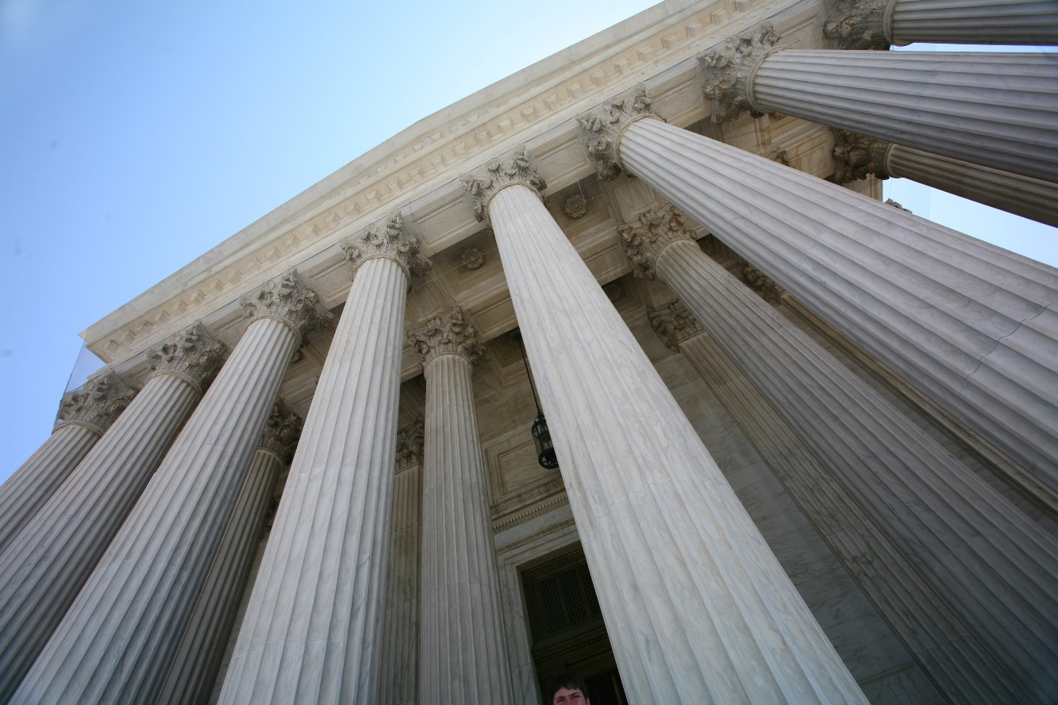
Never Thought You Would Be a Scapegoat
“I was accused of wrongdoing as part of the GSA ‘scandal’. At the time, I had nearly 40 years with the federal government.”
Notes:
Examples of Covered Administrative Actions: A GSA Regional Commissioner, (Ret) was accused of wrongdoing during the GSA scandal. He had a FEDS Protection policy. After nearly 3 years and over $200,000 worth of legal fees, he was vindicated by MSPB – twice.
A federal attorney faces a rigorous investigation by DOJ’s Office of Professional Responsibility for an alleged Brady violation. The policy not only covers the job action, but also defends in the state bar investigation and proceeding arising out of the performance of her federal job duties.
SSA managers within the Office of Disability Adjudication and Review were the subjects of an OIG investigation for allegedly reproducing evidence from one disability case to another in an effort to reduce backlog.
A manager accused of discrimination and whistleblower retaliation is put on administrative leave while higher-level management does an investigation even though the manager has emails from the complainant that will clear the manager.
A Contracting Officer Technical Representative is accused of improperly obligating funds, which resulted in a deficiency act allegation and investigation.

Slide 10
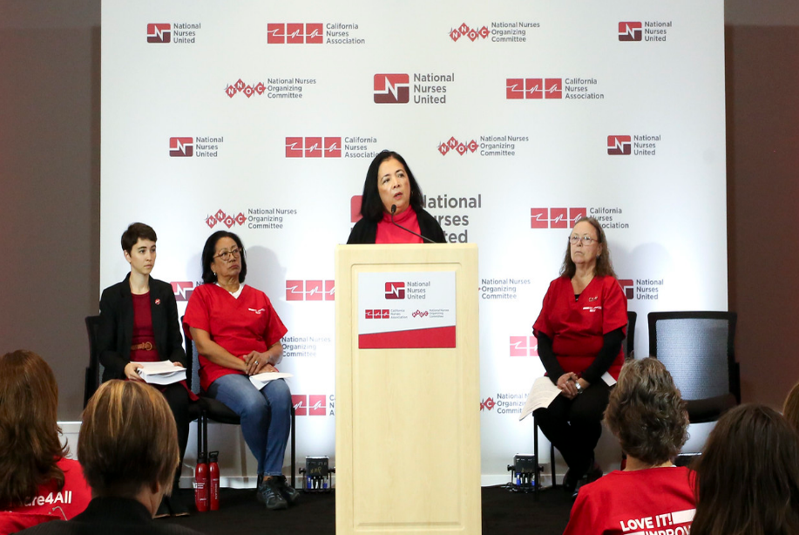
EEO & OSC
The agency’s interest will not always line up with your own.
Complaints
Notes:
Two kinds of investigations I want to quickly mention are EEO and OSC investigations or whistleblower retaliation investigations.
Managers and Supervisors are especially vulnerable to these kind of complaints, strictly due to the nature of their job. This is why Employee Practice Liability Insurance is provided complimentary
Sometimes the agency’s interests and yours are not completely aligned, and in the end, the agency's attorney represent the agency’s interests -- not yours.
And for OSC investigations, agency lawyers will not represent you.

Slide 11
Criminal Investigations
“I cannot believe this is happening to me!”
Notes:
I know most of you didn't’t come to work today intending to commit a federal crime, but as federal officials, you need to appreciate that there is very little you can do wrong in the federal government and not have it also be a violation of the criminal code. IG investigators are criminal investigators first!
Most common criminal investigations involving a federal manager usually involve : Conflict of interest statutes Misappropriation of federal funds; Release of privacy act or other statutorily protected information and/or; any situation arising out of an allegation of misuse of position or authority.
If you are notified you are the subject of a criminal investigation, it is absolutely important for to talk to or retain a criminal defense attorney before you talk to anyone—you also can’t sit around and wait for an indictment.
And when a criminal investigation runs parallel to an administrative investigation, the matter invokes some very complicated constitutional issues.
Waiving your constitutional right against self incrimination is just something you cannot do without consulting an attorney first.

Slide 12
Civil Lawsuits
Up to $1,000,000, $2,000,000, or $3,000,000 to satisfy judgments
Attorneys’ fees to defend the lawsuit if the Department of Justice declines representation
In certain cases, a lawyer to monitor the Department of Justice’s representation
Administrative & Disciplinary Matters
Criminal Proceedings
Up to $200,000 in attorneys’ fees for disciplinary actions including investigations
Up to $100,000 to defend criminal charges

Slide 13
Why NACS Endorses FEDS
Legal Representation
Not Capped by Sub-Limits
Employment Practice Liability Coverage Included for Managers
No Deductibles
Customer Service, Experience, and Know-How
Payroll Deduction Available
Automatic
36-Month Tail Coverage
Notes:
Commitment and Know-How. FEDS President and Founder is a former federal attorney who has continually demonstrated his understanding of and commitment to the entire federal community.
Superior Legal Defense. This is one of the most important differences between the FEDS program and others. The quality of legal representation and counsel that you can expect as a FEDS member is one of the main reasons the leading federal employee associations endorse us.
Legal Representation for Civil Matters is Not Capped by Sublimits. Unlike some carriers, the full $1,000,000, $2,000,000, or $3,000,000 liability limits for civil protection are separate and distinct and not subject to the defense limits of the administrative and criminal provisions.
Coverage is included for managers facing harassment, discrimination, retaliation & wrongful termination allegations. Unlike similar policies, the FEDS policy does not charge additional premium or require you to purchase additional endorsements for Employment Practices Liability claims in order to defend you in the event you are accused of these allegations.

Slide 14
is Affordable
$290* Annually
For FEDS
$1,000,000 policy
Discount Code: NACS
$390* Annually
For FEDS
$2,000,000 policy
$490* Annually
For FEDS
$3,000,000 policy
Agencies will reimburse all supervisors up to 50% of this policy premium. (Reimbursement qualifications and amounts vary by agency – ask your HR Department for details.)
*before applicable taxes and fees
Notes:
Another benefit is that a PLI policy is very affordable. We have a payroll deduction option which is 12-16 a pay period. After reimbursement, if you are eligible, you’re only paying $145-195 annually.
Hiring an attorney who has federal experience will run you $300-$500 per hour. You will spend twice as much for one hour with an attorney than a policy cost for an entire year.
Our policy is less than a dollar a day, for a million dollars of coverage
If you bought the insurance for your entire career and never used it, 5/6k, that is not going to change your standard of living when you retire. Won’t dictate what kind of car you drive; however, if you get caught having to hire your own counsel for what would have been a covered matter, it will impact your standard of living when you retire. Spending thousands on attorneys will have an impact.

Slide 15
866-955-FEDS
fedsprotection.com
You must have coverage in place prior to the allegation, claim or suit, or coverage will not apply!
feds@fedsprotection.com
Notes:
The hardest phone calls we receive are those from employees who don’t have FEDS Protection in place because they never, ever thought they would need an insurance policy to pay for an attorney to defend a job-related action or decision.
Attorneys are expensive, FEDS Protection isn’t. As a matter of fact, FEDS coverage for a year is less than the $300 or $400 per hour you are going to pay for an attorney if you need one.
It takes less than 5 minutes to get enrolled, go to www.fedsprotection.com or call us at 866.955.FEDS.

