Slide 1
Servicing Office
Farm Loan Branch Overview

Slide 2
Servicing Office
In December 2020, the National Financial Accounting and Operations Center (NFAOC) was reorganized into two new organizations: The Servicing Office and the Finance Office; both report to the Rural Development Business Center.
Servicing Office mission: Provide loan servicing performance and efficiency for Rural Development (RD) and Farm Service Agency (FSA) programs through exemplary customer service and fiscal stewardship while cultivating a highly productive workforce.
Even though organizationally separate, our functions to support FSA continue to be intertwined; therefore, we will continue to provide exceptional loan servicing and financial services.
RD Business Center
Servicing Office
Finance Office

Slide 3
Overview of the Farm Loan Branch (FLB)
  The Farm Service Agency offers loans to help farmers and ranchers get the financing they need to start, expand or maintain a family farm. FLB has a “Service Level Agreement” with the Farm Service Agency to provide servicing and financial reporting functions for the Farm Loan Program portfolio.
  The Farm Loan Branch is mainly responsible for planning, organizing, directing, and coordinating loan servicing and management reporting activities related to the development, maintenance, and operation of the detail “accounting systems” for direct loans in the Farm Loan Portfolio.

Slide 4
Overview of the Farm Loan Branch (FLB) – Cont.
  Team members process a full range of borrower accounting transactions for all direct loans serviced by the Farm Loan Program portfolio, such as discrepancy processing, consolidations, re-amortizations, refunds and changes in application of payments.
  FLB currently processes transactions out of two systems which are the Program Loan Accounting System (PLAS) and Direct Loan System (DLS).

Slide 5
Farm Loan Portfolio Stats as of
December 31, 2022
Portfolio | Unpaid Principal Balance | # of loans
FSA | $32,405,567,907 | 188,878

Slide 6
FY23 Outreach Initiatives
Farm Loan Branch will continue to work along side National Office to process Inflation Reduction Act (IRA) payments and any requested corrections
Smaller Outreach Meetings
Daily Reports of Tech ADPS Processing and ECM completions

Slide 7
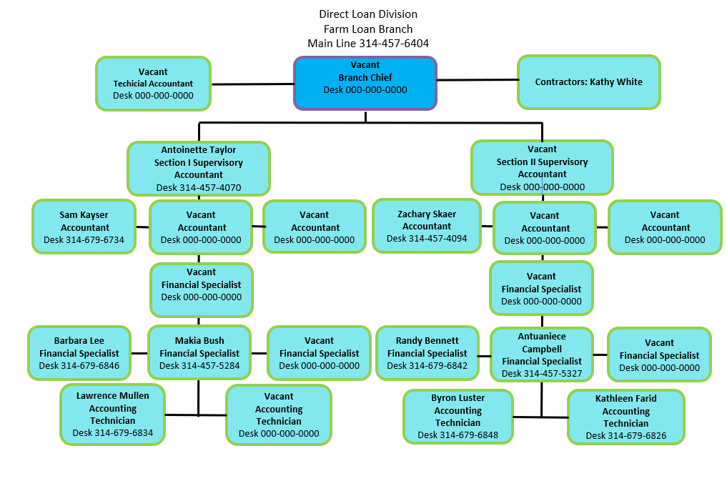

Slide 8
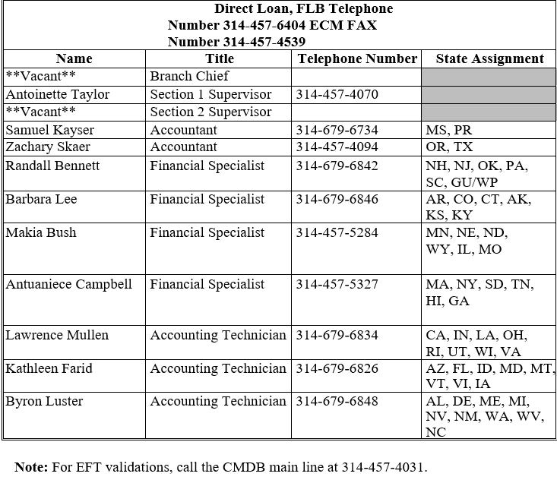
Contact Information – Farm Loan Branch

Slide 9
Direct FLP Processing Times – Farm Loan Branch
5 Business Days:
  All Disbursements
  Emergency Loan Funds
  Emergency Loan Costs
10 Business Days:
  FSA 2072, Cancellation of U.S. Treasury Check and/or Obligation
  FSA 2425, Request to Cancel Undisbursed Loan Funds
  FSA 2732, Request for Settlement of Indebtedness with an Application
  FSA 2731, Request for Settlement of Indebtedness without an Application
  FSA 2722, TOP or Cross Servicing Refunds

Slide 10
Direct FLP Processing Times Cont. – Farm Loan Branch
12 Business Days:
  FSA 2429, Changes in Application of Payment
20 Business Days:
  FSA 2560, Request for Statement of Account
  FSA 2446, PLAS Account Correction (Type of Assistance Correction, Complex Cases, Refunds of Overpayment)
  FSA 2574, Confirmation Reorganization Plan Worksheet (Bankruptcies)
  FSA 2576, Notice of Judgement
30 Business Days:
  ADPS Discrepancies

Slide 11
Reminders – Farm Loan Branch
ECM Requests
  Include on the fax cover sheet an email address(s) for the purpose of emailing the notification receipt letter. If you need to verify the ECM request has been received through fax, please contact the Financial Specialist team
ECM status or questions
  Please contact the Accounting Technician that is responsible for the state or the “Assigned to” person listed on the receipt letter for the request in question
  If no response in one business day forward the email that was originally sent to the Accounting Technician to our Financial Specialist team
  If no response in one business day forward the email that was originally sent to the Financial Specialist to Antoinette Taylor. Always respond to your original email because we need that information to ensure the proper channels were used.
Financial Specialist | Email Adress
Bennett, Randall | randall.bennett@usda.gov
Campbell, Antuaniece | antuaniece.campbell@usda.gov
Bush, Makia | Makia.Bush@usda.gov
Lee, Barbara | barbara.lee@usda.gov

Slide 12
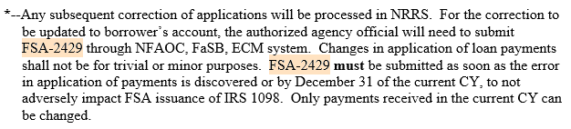
Reminders Cont. – Farm Loan Branch
NRRS requests
  Please contact Sue Eilertson at sue.eilertson@usda.gov or at 202-690-9142
FSA 2429
  4 FLP directions, Page 5-1

